Slide 1
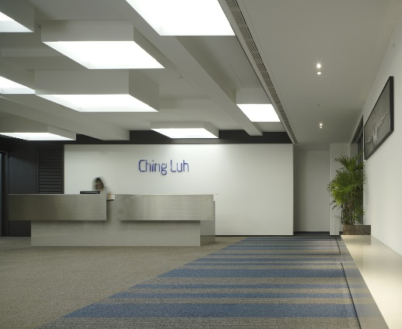
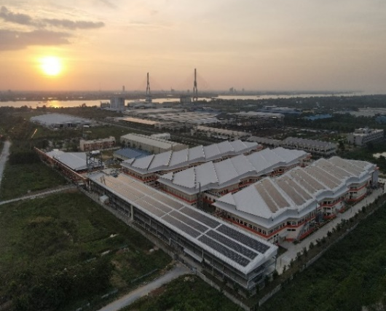

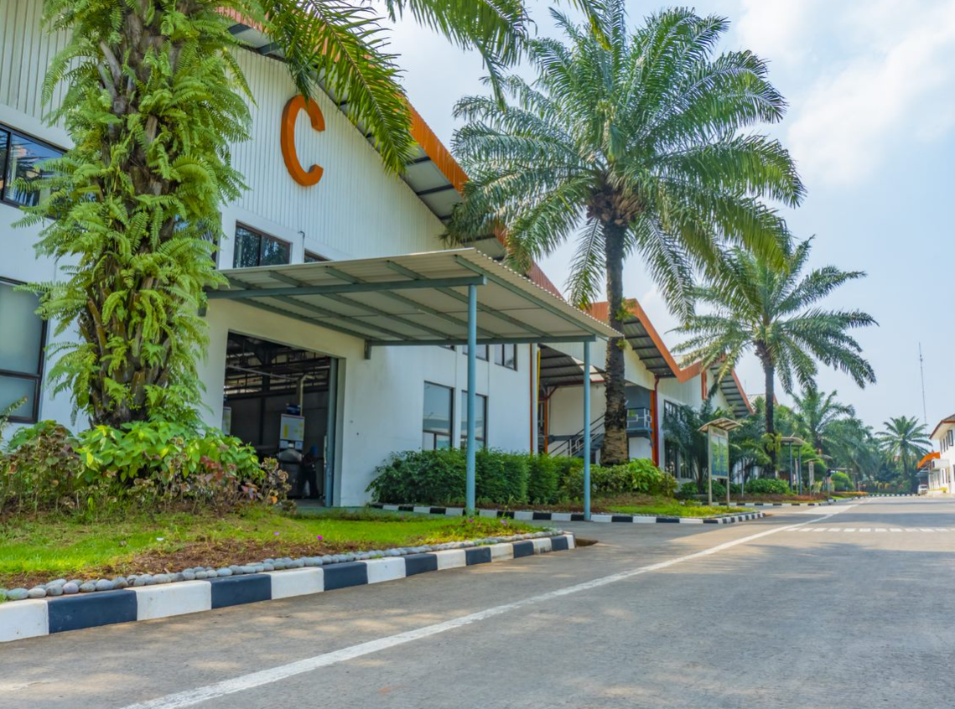


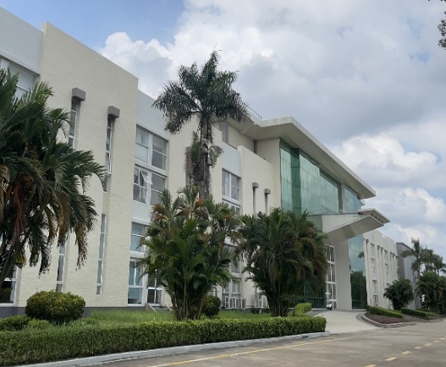
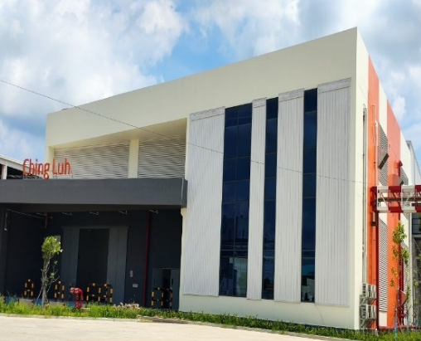
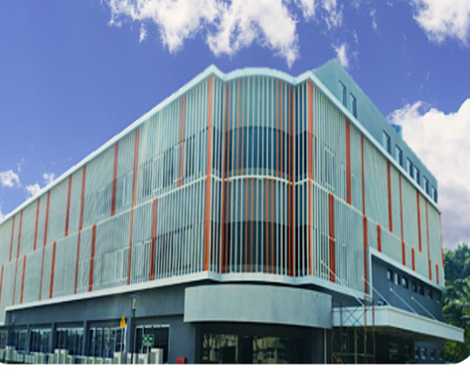
SOP TRANSLATION STRATEGY

Slide 2
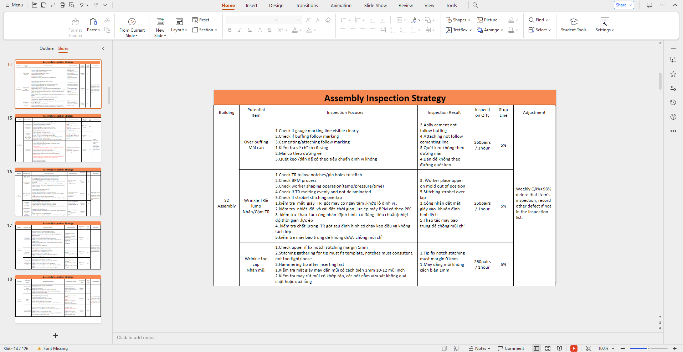
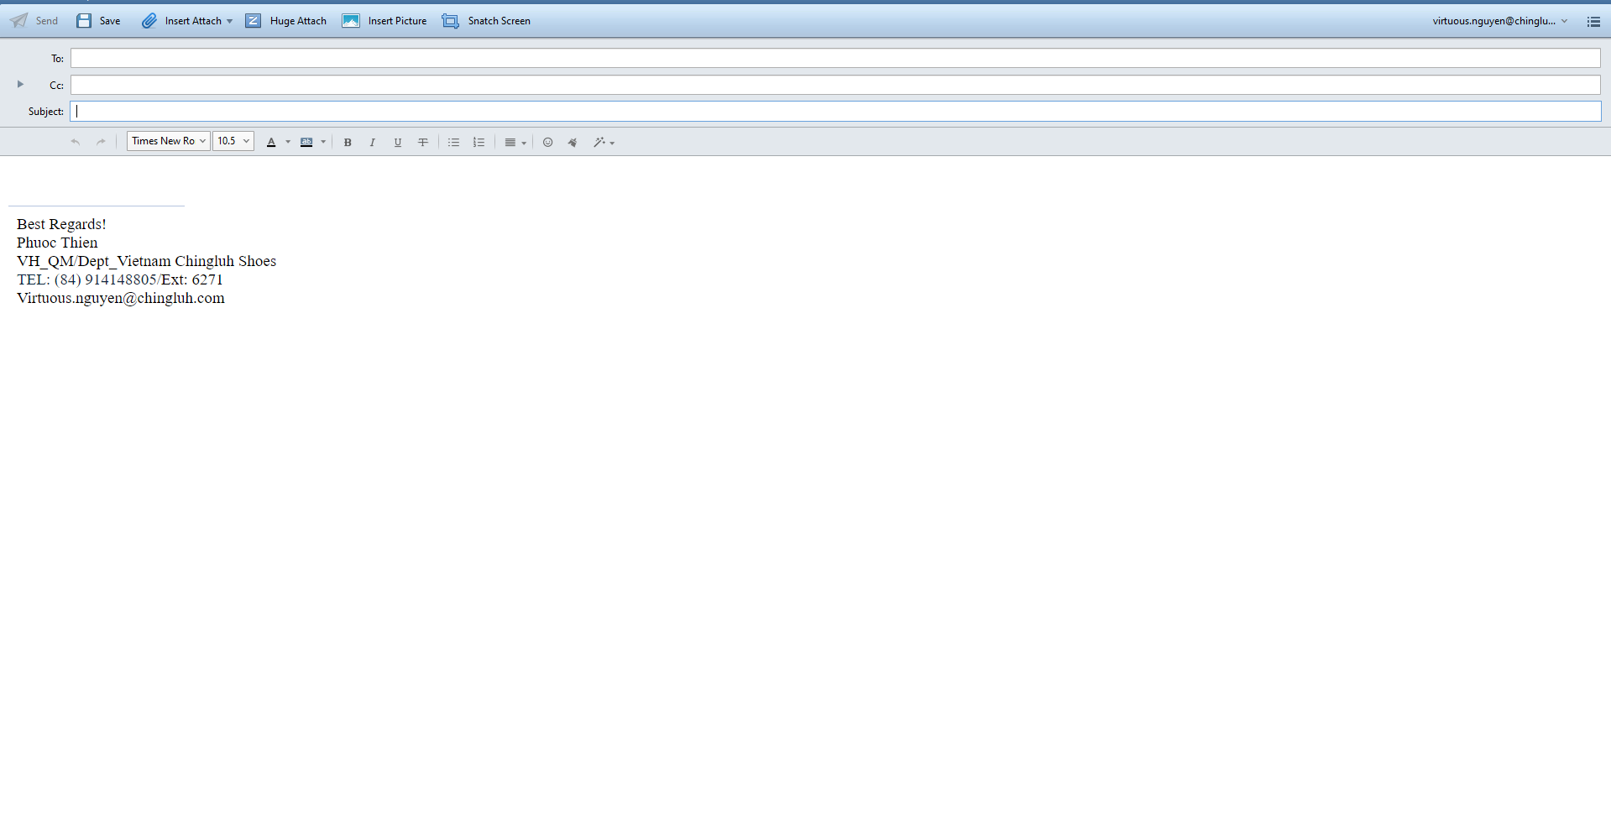
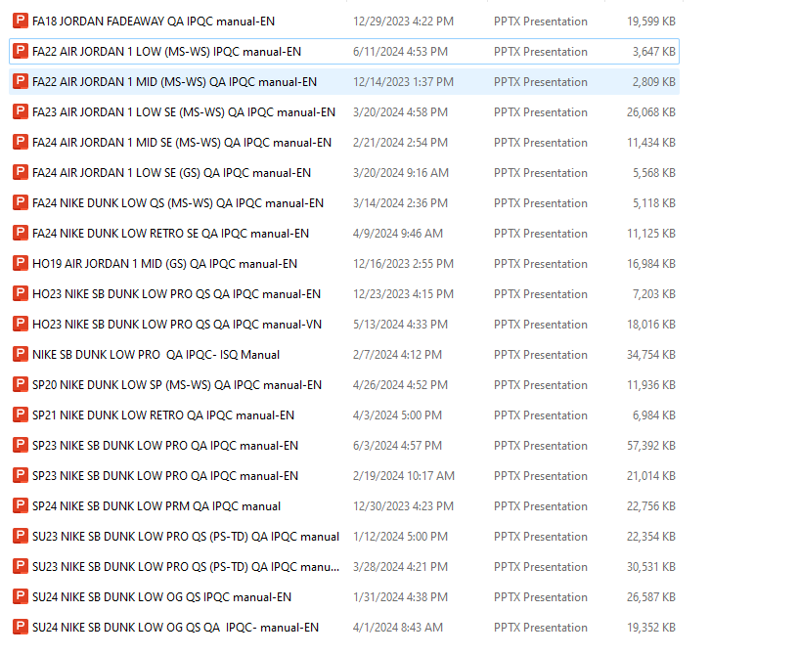
STRATEGY SPECIFICATION
Step 1
Step 3
Send email
After completing, check the content, font size,...
Step 2
Strategy file name specification
For SF
SU22 STOCKFIT WMNS NIKE ONEONTA SANDAL IPQC manual-EN
HO22 STOCKFIT JORDAN 23-7 (PS-TD) QA IPQC manual-EN
For Sandals
SU23 WMNS NIKE OFFCOURT DUO SLIDE IPQC manual-EN
For Shoe
SP22 AIR JORDAN 1 LOW (GS) QA IPQC manual-EN
SP22 AIR JORDAN 1 LOW (PS-TD) QA IPQC manual-EN
Check if the strategy file name follow specifications.
Remark
EN translation should finish within 3 working days, starting from the time receiving the email from the sender

Slide 3
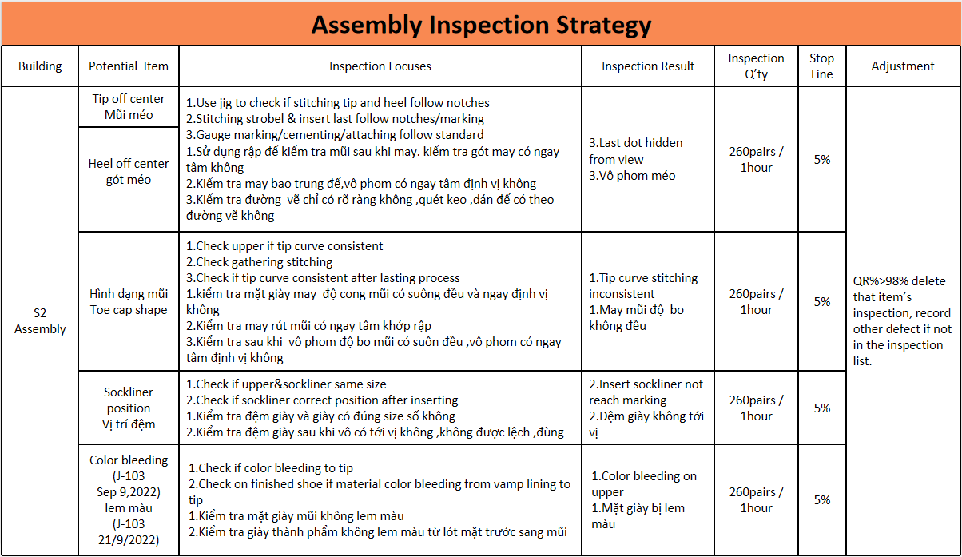
TRANSLATE FOR IPQC
FOR NEW STRATEGY
Keep the Vietnamese (do not remove) when translating.
Translate and separate English and Vietnamese. English can be placed above, Vietnamese below or reverse. Make sure match for all slides.
In case the table extends beyond the slide cause content is too much. You should not delete anything or create a new slide, continue until all translation is completed.

Slide 4
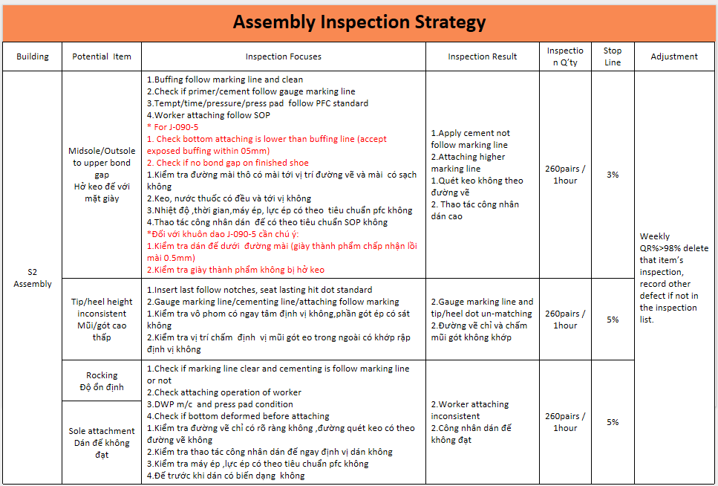
TRANSLATE FOR IPQC
FOR ADD CONTENT
Translate and separate English and Vietnamese.
In case the table extends beyond the slide cause content is too much. You should not delete anything or create a new slide, continue until all translation is completed.

Slide 5
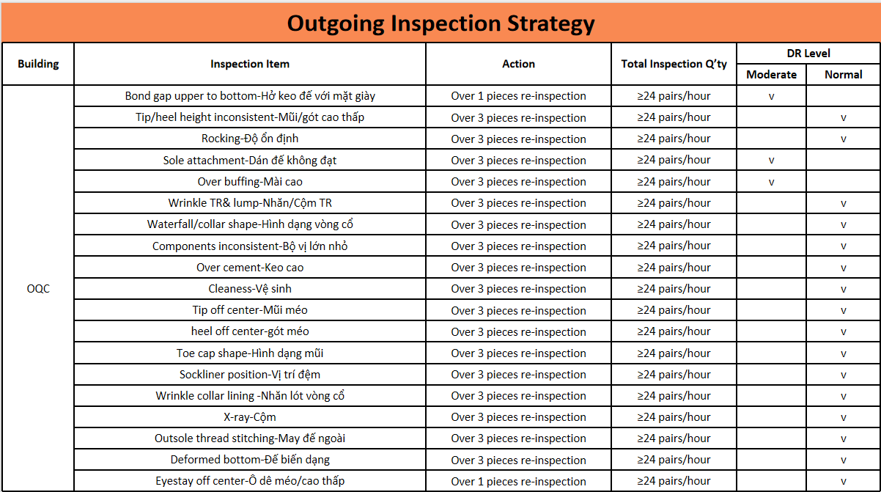
TRANSLATE FOR IPQC
FOR NEW STRATEGY
Check if the content is complete, exact EN and VI.

Slide 6
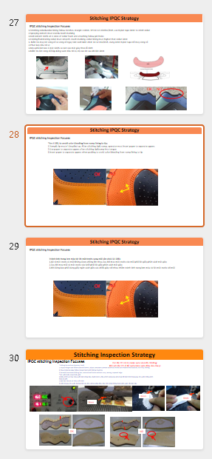
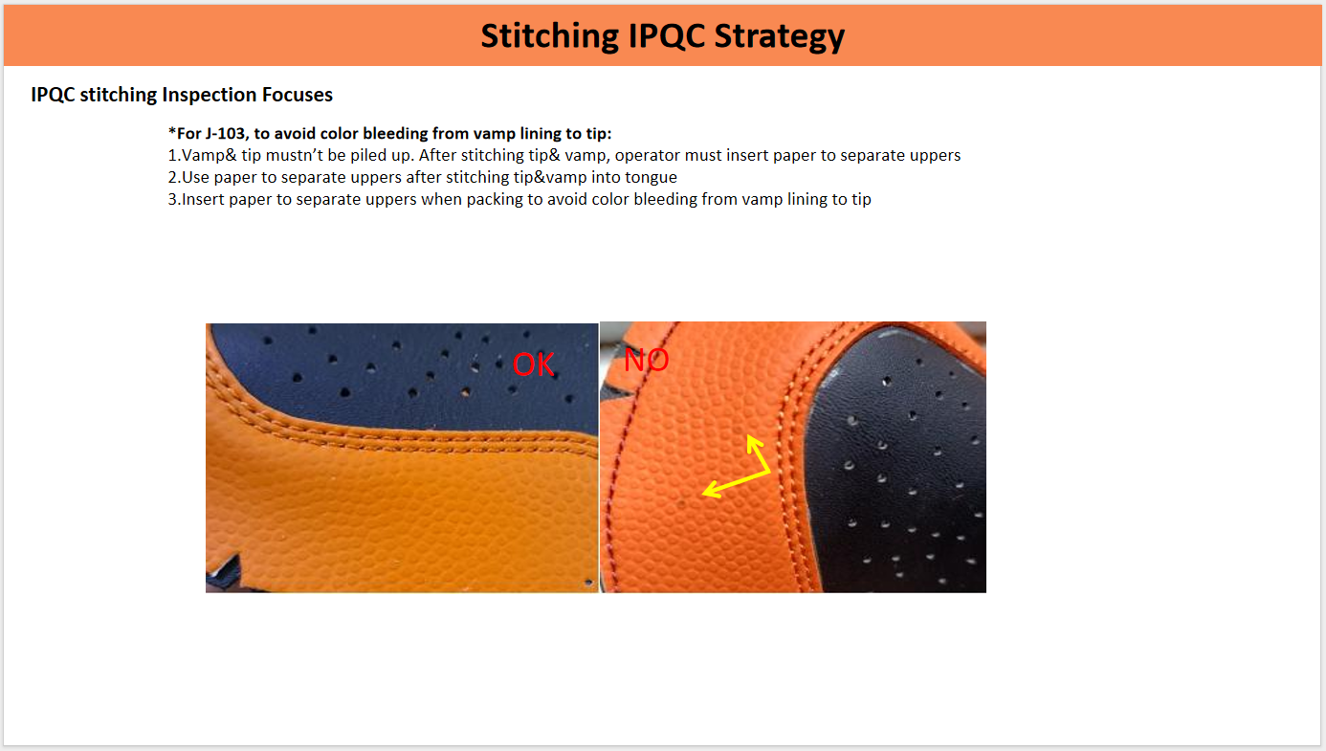
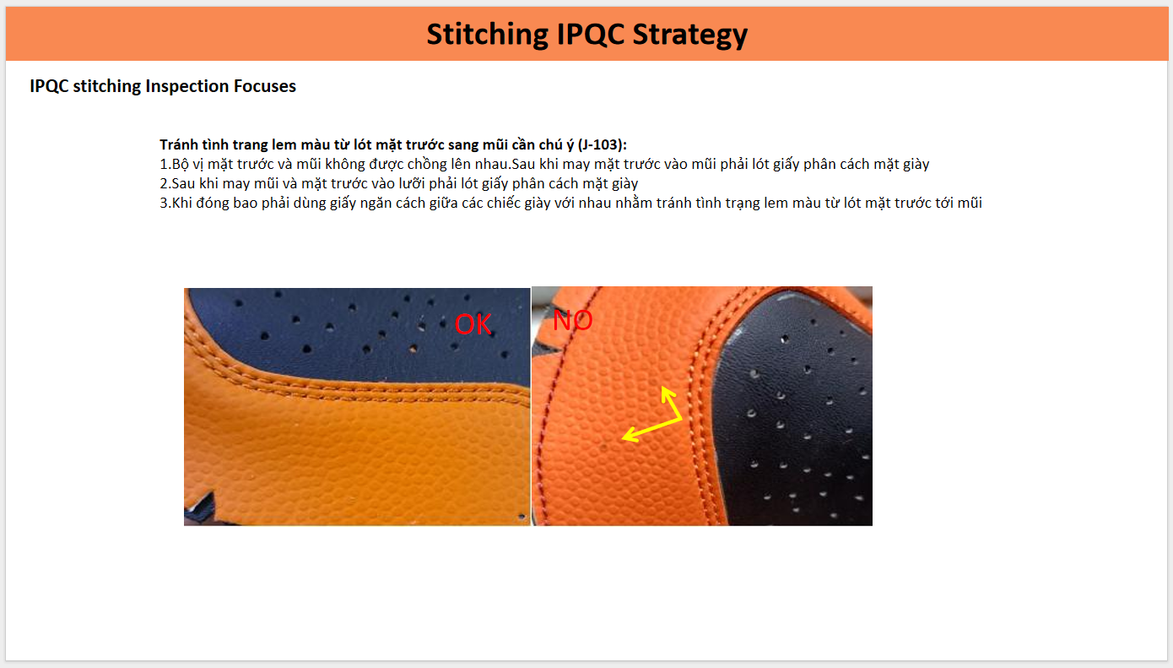
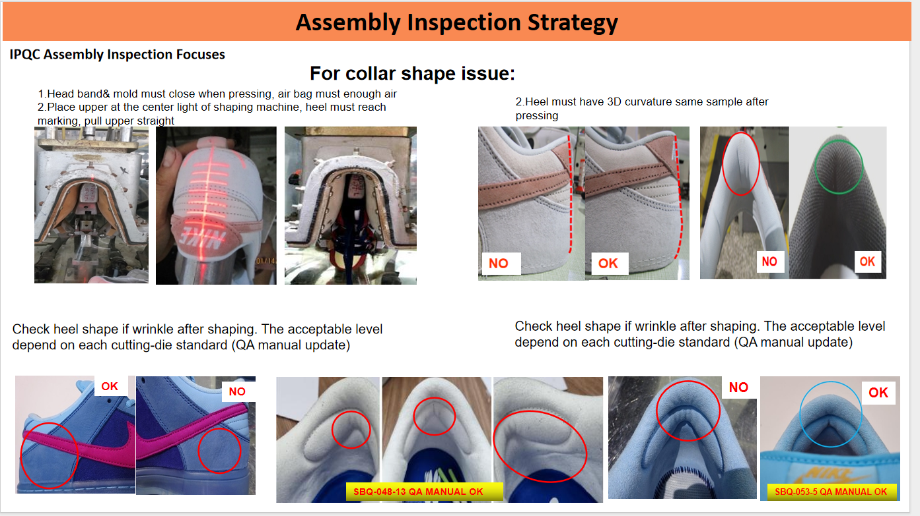
TRANSLATE FOR IPQC
FOR NEW STRATEGY/ADD CONTENT
Translate and separate 1 Vietnamese page and 1 corresponding English page. Make sure match for all slides.
Remark
If there are many pictures and we don’t have enough space to translate, we can copy this page and paste the next corresponding page to translate.

Slide 7
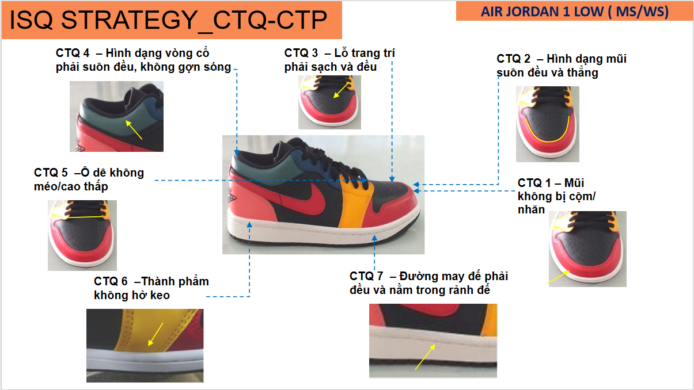

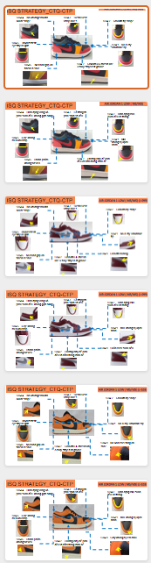
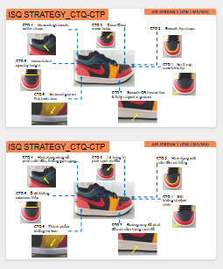
TRANSLATE FOR ISQ
FOR NEW STRATEGY/ADD CONTENT
Step 1
Step 2
For this slide, copy and paste at below
Translate 1 page in English and keep 1 page in Vietnamese at below
Sample picture
Sample picture
Remark
In case there are many cutting dies. For each cutting die, there will be 1 English page and 1 Vietnamese page below

Slide 8
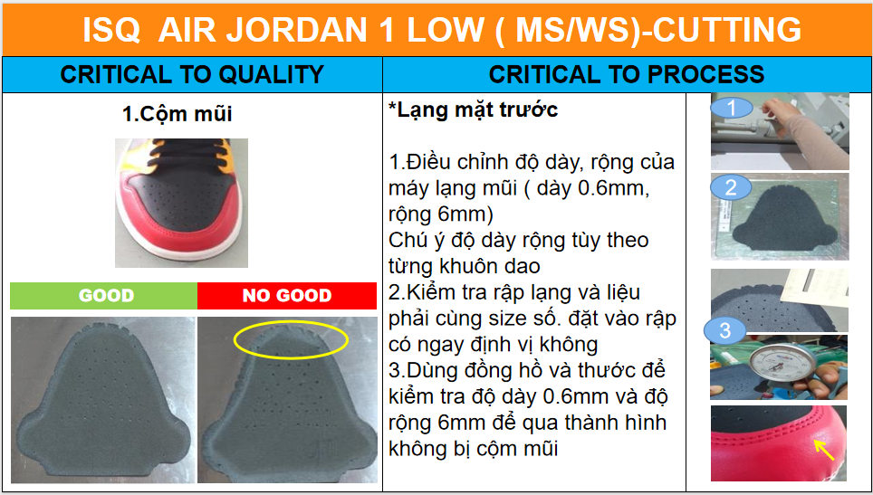
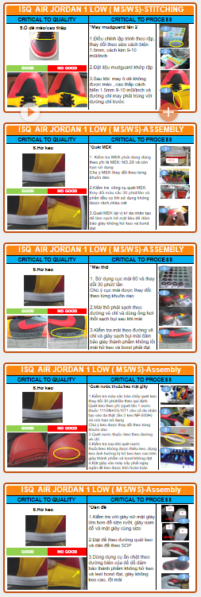
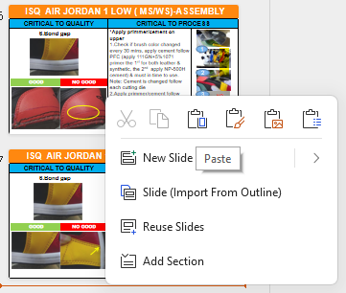
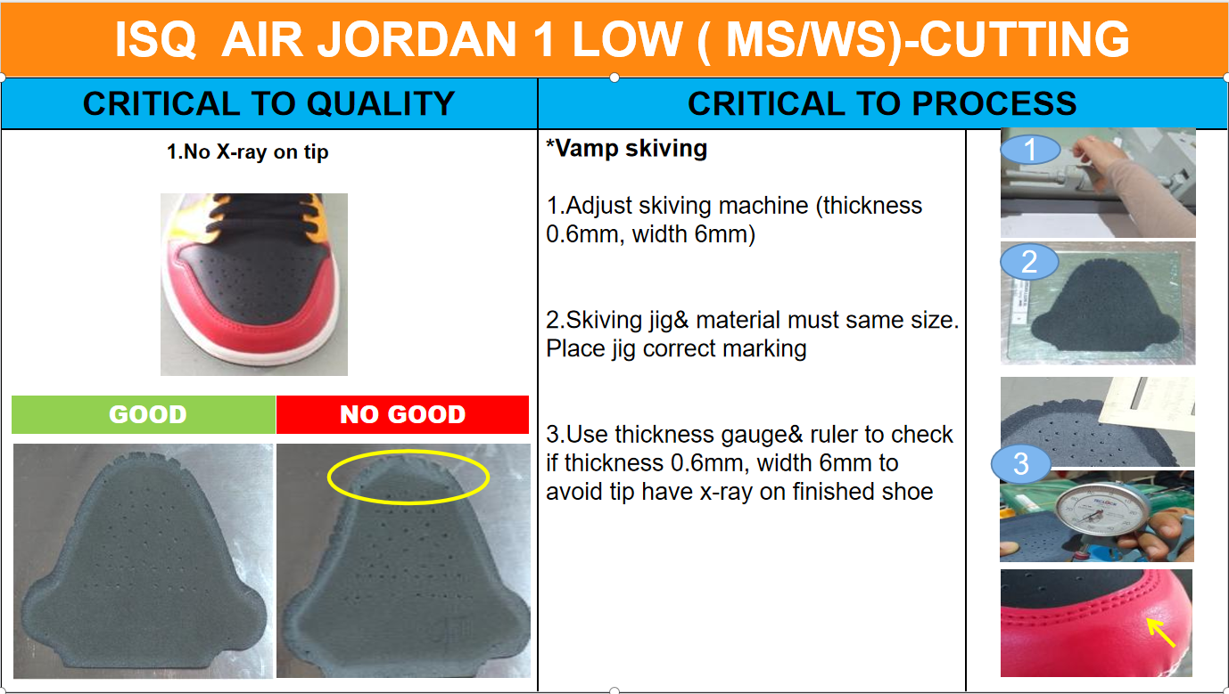
TRANSLATE FOR ISQ
FOR NEW STRATEGY
Step 1
Step 2
Paste at the end of slide
For this slide, copy from the starting to the last slide.
Step 3
Translate and edit follow original form of page (remove VI). Make sure match for all slides and only translate the above, do not translate the Vietnamese copy below

Slide 9
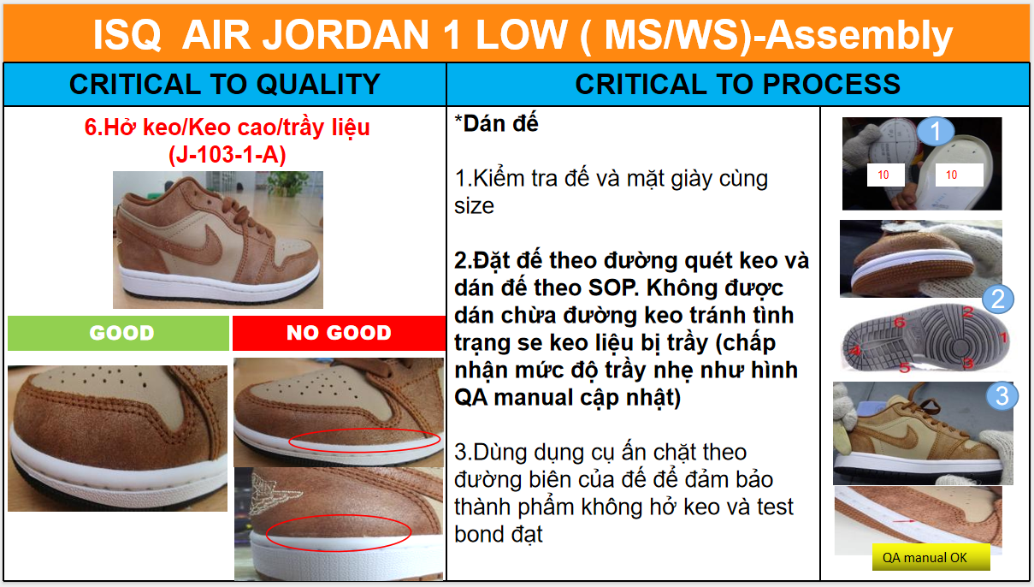
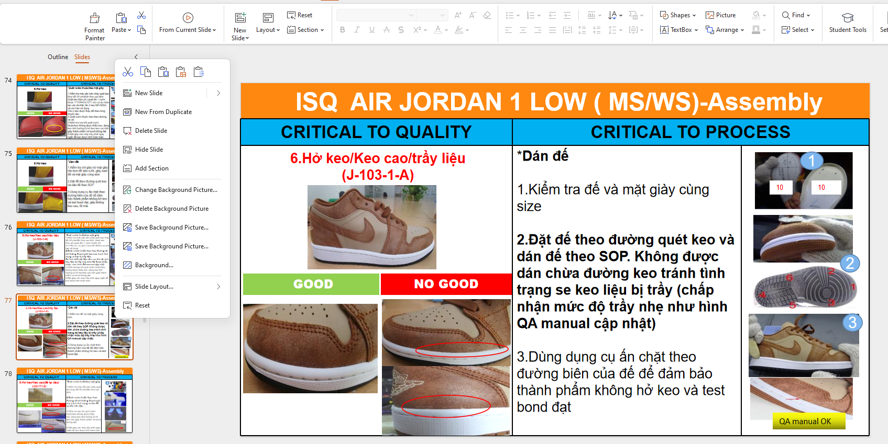
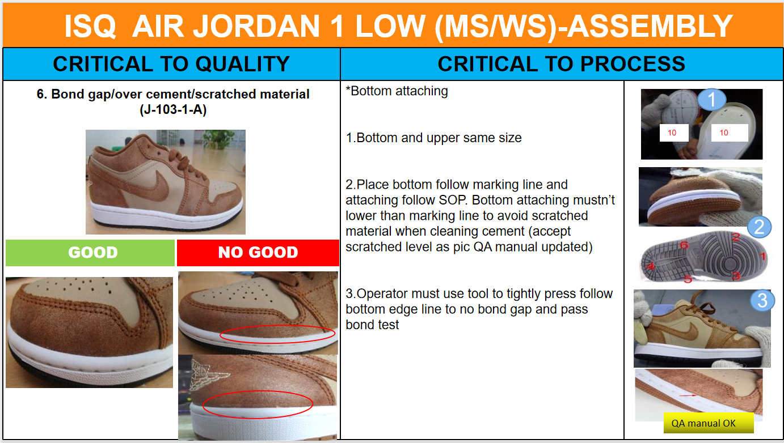
TRANSLATE FOR ISQ
FOR ADD CONTENT
Step 1
Step 2
For new ISQ page , copy that new page
Paste to corresponding page at EN version
Step 3
Translate and edit follow original form of pagec (remove VI). Make sure match for all slides and only translate the above, do not translate the Vietnamese copy below

Slide 10
VOCABULARY FOR STRATEGY
VI | EN
Ố | Stain
Bỏ mũi | Skip stitching
Sụp mí | Run off stitching
Đứt chỉ | Broken thread
Bọt khí | Air bubble
Dơ | Contamination
Độ gập ghềnh/ổn định | Rocking
Đường phân khuôn | Parting line
Đường rảnh | Groove line
Đường định vị | Marking line
Đường viền | Binding line
Hở keo | Bond gap
Hoa văn không đạt | Poor texture
Khoảng chêch lệch | Tolerance
Không đều | Inconsistent
Kiểm định | Cabiration
Làm lạnh | Chilling
Lập thể | Definition
Lem màu | Color bleeding
Lỗ chặt | Cutting holes
Lỗ dây giày | Eyelet
Lỗ định vị trên rập/khuôn | Pin holes
VI | EN
Thớt chặt | Cutting board
May 2 mũi | Double stitching
Máy cán | Roller mixing
Dây thun | Elastic band
Bao trung đế | Strobel stitching
Máy định hình 3D | 3D shaping machine
May rút mũi | Gather stitching
Máy trộn | Kneader mixing
Máy xén | Trimming machine
Ngâm nước | Dipping
Ngấn | Visible mark
Nhét giấy | Stuffing tissue paper
Nhiều miếng nhỏ | Several pieces
Nới lỏng | Looseing lace
Nước tẩy dầu mỡ | Water degreasing
Nước thuốc | Primer
Ô dê | Eyestay
Phát liệu thô | Raw material
Phát phồng | Foaming
Phím thử L/S | Pouring L/S stabs
Phím thử M | Slabs injection
Phụ kiện | Unit sole
VI | EN
Quét tem | Scan bancode
Rà kim loại | Metal detection
Rách | Tear
Sấy định hình | Stabilization
Sấy nóng | Heating
Sự co rút | Shrinkage
Tâm | Notches
Tạo hạt | Pellectazation
Thủ công | Manual
Trộn liệu | Bending
Lộn lại/lộn dây | turning/strap turn
Trụ ép | Pillars
Tróc sơn | Paint peeled off
Lem sơn | Over painting
Keo cao | Over cement
Mài cao | Over buffing
Nổi mốc | Moldy
Ngoại quan đế | Bottom Cosmetic
Đầu chỉ | Thread end
Cộm | X-ray
Lệch vị | Off position
Đế lõm | Bbottom concave

Slide 11


